Slide 1

V – Programming Language Advanced Software Paradigms_CSCI_6221_10
Abde Manaaf Ghadiali – G29583342
Gehna Ahuja – G35741419
Venkatesh Shanmugam – G27887303
Vikra Krishnasamy – G43933001
Notes:
Hello Everyone,
Hope everybody is having a great day.
Today marks a significant milestone as we unveil an innovative and swiftly advancing programming language, V or Vlang.

Slide 2
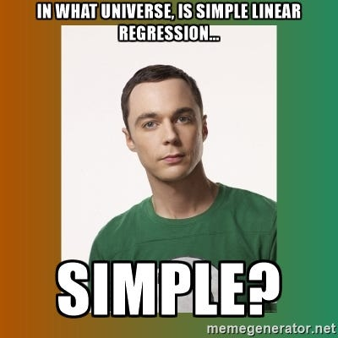
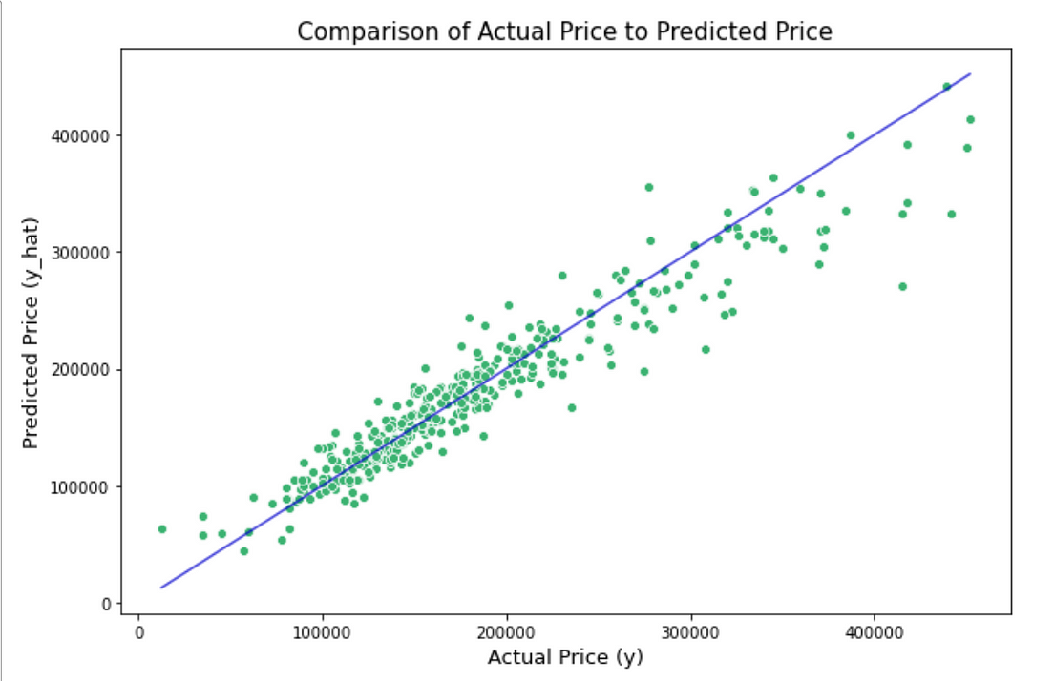
V-Regress (An ML initiative in V-Lang)
Objective of the Project – Create a library in Vlang, which can provide us with a Simple Linear Regression Model.
Constraints – Only Functions and Structs, works on Excel Data, Dataset consist of one independent feature (x) and one dependent feature (y).
Features –
Reads Data From Excel
Creates a Serialized binary file (which can be imported in Python)
Plots the Regression Line
Gives you the x-Coefficient and the intercept
Technology Stack – Vlang, VSCode, Google and Chat-GPT (This one is obvious)
Where can we use this?
To create a full-fledged ML Library in Vlang
Influence People to create more ML Libraries in Vlang
Predicting Prices of Houses that only depend on the Size of the House
Notes:
We are currently developing V-Regress, an ML-specific library within the V ecosystem, focusing on providing a simple linear regression solution. Given the vast scope of Machine Learning and Linear Regression, our emphasis will be on fundamental concepts, concentrating on a singular feature and target variable.
Outlined below are the key features of our project:
Seamless integration for data extraction from Excel files.
Creation of a serializable binary of the ML model, facilitating easy implementation within any Python program.
Incorporation of a visualization component, enabling users to observe the Regression Line's plot for both the feature and target variables.
The provision of X-Coefficient and intercept data, empowering users to replicate results and make informed future predictions.
In terms of technology, our project will rely on pivotal resources including ChatGPT, Google services, comprehensive Vlang documentation, and select Vlang plugins for VScode.
The practical applications of this solution extend beyond its technical merits. This initiative represents a significant step towards fostering an ML community within V, inspiring the creation of more sophisticated ML constructs. Moreover, our project serves as a critical tool for predicting house prices, particularly those contingent upon house size, contributing to informed decision-making within the real estate domain.
Moreover, our project serves as a critical tool for predicting house prices, which only depend on the size of the house.

Slide 3
V-Regress – (Delivery) (An ML initiative in V-Lang)
Features of the Project:
Read Excel Data and store it in a Dataframe (tabular library had to be created) (One Feature vs One Target and Multi-Feature vs One Target).
Linear Regression Library (or Module) which can be imported and used on the data provided (provides a fit_model function and a predict function for future predictions).
Visualize the Excel data in a tabular fashion with restricted number of rows (Similar to pandas in python).
Generates a model object (Struct Type) with the updated weights and bias, as well as the R^2 Value (used to access the model accuracy).
Generates a Visual Graph for observing the regression trend line with the actual vs predicted (using python’s Plotly library for visually appealing graphs).
Extras:
Fully Commented and Documented code files in a modular fashion.
Saves the graph to a .jpeg image file for future use.

Slide 4
V-Regress – (Comparison) (An ML initiative in V-Lang)
What was Promised? | What have we Delivered?
Reads Data From Excel File (as a List of Lists). | Reads Data from Excel File (as a Dataframe) and prints in a tabular format.
Creates a Serialized Binary file. | Executes a Python script using os.execute() function and sends the weights and bias to the script.
One Feature vs One Target. | Multi-Feature vs One Target.
Gives the X-coefficient and the Intercept. | Provides a Model Struct with the Weights (for Multi-Feature), bias and R^2 Value for accuracy.
Plots the Regression Line. | Plots the Regression Line with the actual data (Feature and Target).
Simple Linear Regression. | Multi-Feature Linear Regression with Gradient Descent.
ML Community in V-Lang. | ML Community through our Github Repository.

Slide 5

Thank You
The floor is open to Questions!
Notes:
Thank you all for your attention and patience throughout this presentation. I now invite any questions or inquiries you may have. Please feel free to engage and share your thoughts.

